Slide 1
Chapter 14
Introduction to Normalization Using Functional and Multivalued Dependencies

Slide 2
Chapter 14 Outline
Informal Design Guidelines for Relation Schemas
Functional Dependencies
Normal Forms Based on Primary Keys
General Definitions of Second and Third Normal Forms
Boyce-Codd Normal Form

Slide 3
Introduction
Levels at which we can discuss goodness of relation schemas
  Logical (or conceptual) level
  Implementation (or physical storage) level
Approaches to database design:
  Bottom-up or top-down

Slide 4
Informal Design Guidelines for Relation Schemas
Measures of quality
  Making sure attribute semantics are clear
  Reducing redundant information in tuples
  Reducing NULL values in tuples
  Disallowing possibility of generating spurious tuples

Slide 8
Guideline 1
Design relation schema so that it is easy to explain its meaning
Do not combine attributes from multiple entity types and relationship types into a single relation
Example of violating Guideline 1: Figure 14.3

Slide 9
Guideline 1 (cont’d.)

Slide 10
Redundant Information in Tuples and Update Anomalies
Grouping attributes into relation schemas
  Significant effect on storage space
Storing natural joins of base relations leads to update anomalies
Types of update anomalies:
  Insertion
  Deletion
  Modification

Slide 11
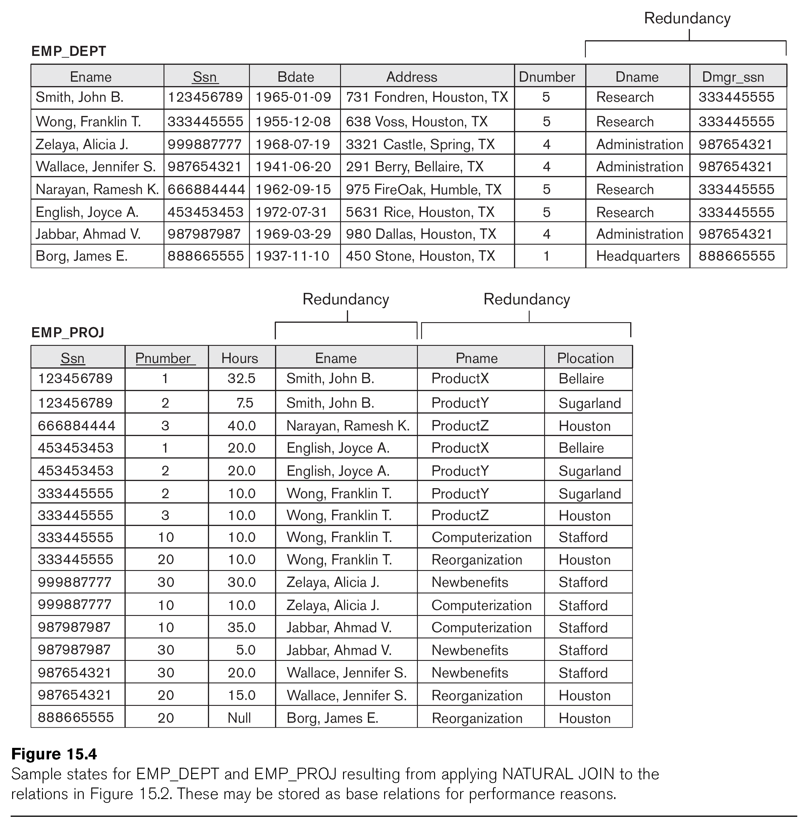

Slide 12
Guideline 2
Design base relation schemas so that no update anomalies are present in the relations
If any anomalies are present:
  Note them clearly
  Make sure that the programs that update the database will operate correctly

Slide 13

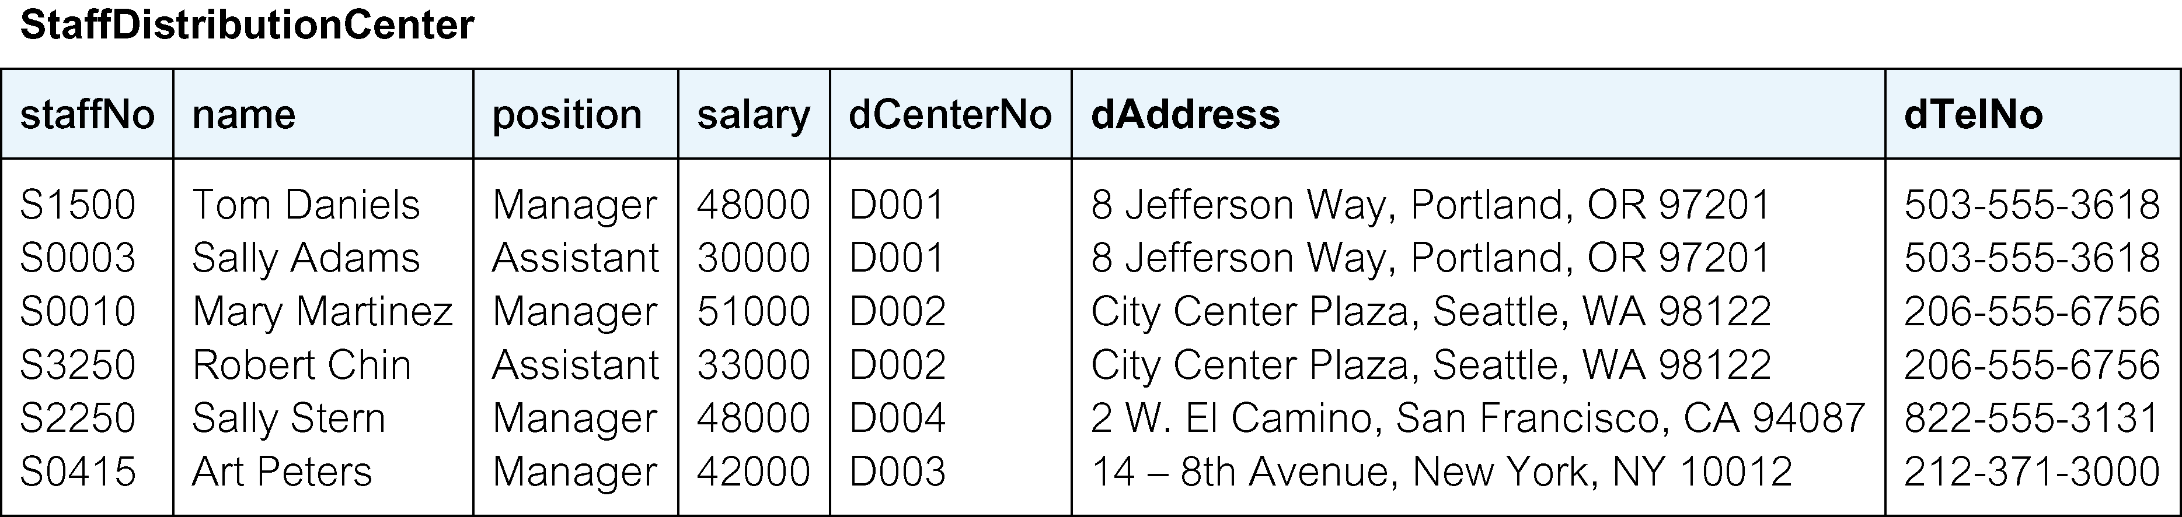
Staff and DistributionCenter tables with StaffDistributionCenter table

Slide 14
NULL Values in Tuples
May group many attributes together into a “fat” relation
  Can end up with many NULLs
Problems with NULLs
  Wasted storage space
  Problems understanding meaning

Slide 15
Guideline 3
Avoid placing attributes in a base relation whose values may frequently be NULL
If NULLs are unavoidable:
  Make sure that they apply in exceptional cases only, not to a majority of tuples

Slide 18
Guideline 4
Design relation schemas to be joined with equality conditions on attributes that are appropriately related
  Guarantees that no spurious tuples are generated
Avoid relations that contain matching attributes that are not (foreign key, primary key) combinations

Slide 19
Summary and Discussion of Design Guidelines
Anomalies cause redundant work to be done
Waste of storage space due to NULLs
Difficulty of performing operations and joins due to NULL values
Generation of invalid and spurious data during joins

Slide 20
Functional Dependencies
Formal tool for analysis of relational schemas
Enables us to detect and describe some of the above-mentioned problems in precise terms
Theory of functional dependency

Slide 21
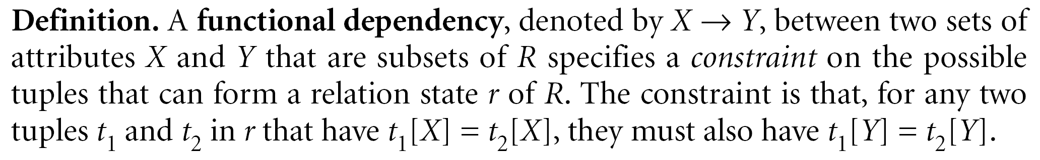
Definition of Functional Dependency
Constraint between two sets of attributes from the database
Property of semantics or meaning of the attributes
Legal relation states
  Satisfy the functional dependency constraints

Slide 22
Definition of Functional Dependency (cont’d.)
Given a populated relation
  Cannot determine which FDs hold and which do not
  Unless meaning of and relationships among attributes known
  Can state that FD does not hold if there are tuples that show violation of such an FD

Slide 23
Normal Forms Based on Primary Keys
Normalization process
Approaches for relational schema design
  Perform a conceptual schema design using a conceptual model then map conceptual design into a set of relations
  Design relations based on external knowledge derived from existing implementation of files or forms or reports

Slide 24

Normalization of Relations
Takes a relation schema through a series of tests
  Certify whether it satisfies a certain normal form
  Proceeds in a top-down fashion
Normal form tests

Slide 25
Normalization of Relations (cont’d.)
Properties that the relational schemas should have:
  Nonadditive join property
    Extremely critical
  Dependency preservation property
    Desirable but sometimes sacrificed for other factors

Slide 26
Practical Use of Normal Forms
Normalization carried out in practice
  Resulting designs are of high quality and meet the desirable properties stated previously
  Pays particular attention to normalization only up to 3NF, BCNF, or at most 4NF
Do not need to normalize to the highest possible normal form

Slide 27

Definitions of Keys and Attributes Participating in Keys
Definition of superkey and key
Candidate key
  If more than one key in a relation schema
    One is primary key
    Others are secondary keys

Slide 28
First Normal Form
Part of the formal definition of a relation in the basic (flat) relational model
Only attribute values permitted are single atomic (or indivisible) values
Techniques to achieve first normal form
  Remove attribute and place in separate relation
  Expand the key
  Use several atomic attributes

Slide 29
First Normal Form (cont’d.)
Does not allow nested relations
  Each tuple can have a relation within it
To change to 1NF:
  Remove nested relation attributes into a new relation
  Propagate the primary key into it
  Unnest relation into a set of 1NF relations

Slide 31
First normal form (1NF)
Only 1NF is critical in creating appropriate tables for relational databases. All subsequent normal forms are optional.
A table in which the intersection of every column and record contains only one value.

Slide 32
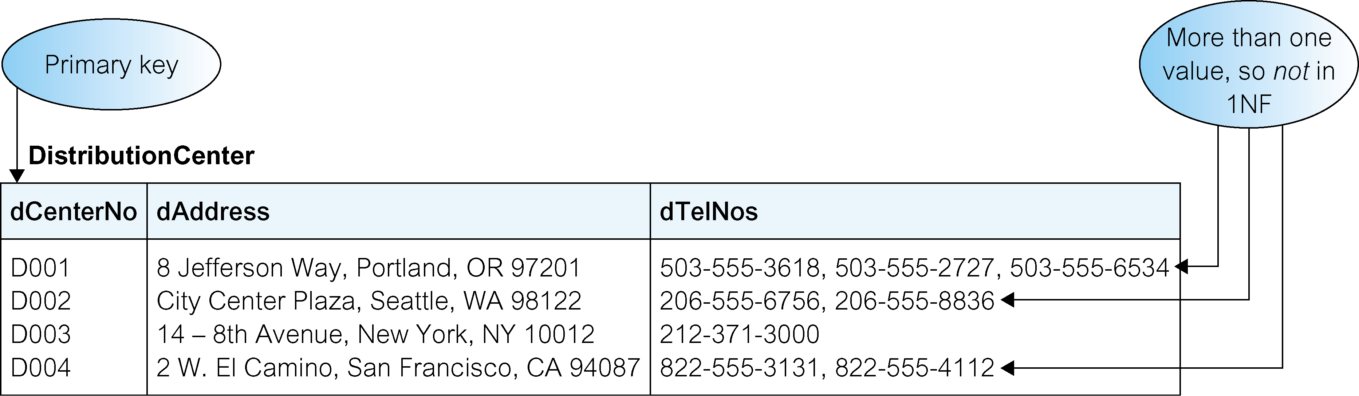
DistributionCenter table is not in 1NF

Slide 33
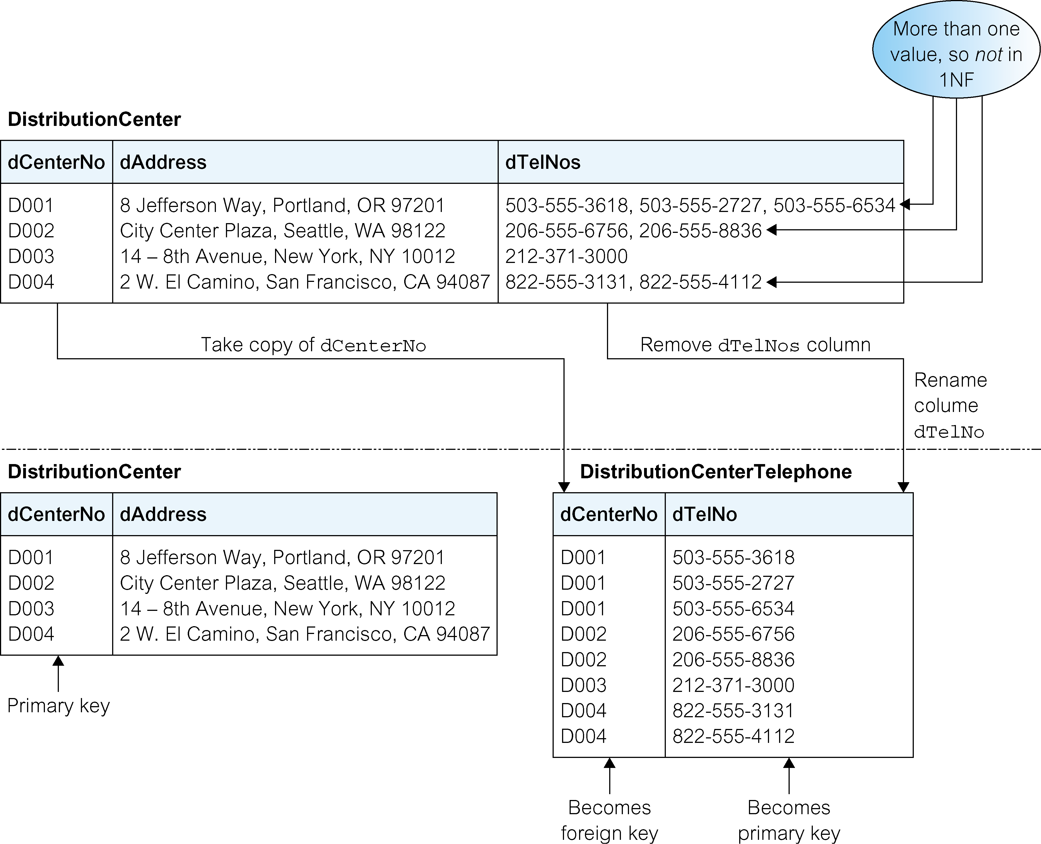
Converting DistributionCenter table to 1NF

Slide 34
Second Normal Form
Based on concept of full functional dependency
  Versus partial dependency
Second normalize into a number of 2NF relations
  Nonprime attributes are associated only with part of primary key on which they are fully functionally dependent

Slide 35
Third Normal Form
Based on concept of transitive dependency
Problematic FD
  Left-hand side is part of primary key
  Left-hand side is a nonkey attribute

Slide 36
Second normal form (2NF)
A table that is in 1NF and in which the values of each non-primary-key column are determined by the values in all the columns that make up the primary key.
To assess whether a table breaks 2NF form requires identification of the primary key and functional dependencies associated with that table.
2NF only applies to tables with composite primary keys.

Slide 37
Functional dependency
Describes the relationship between columns in a table and indicates how columns relate to one another.
For example, consider a table with columns a and b, where b is functionally dependent on a (denoted a → b). If we know the value of a, we find only one value of b in all the records that has this value of a, at any moment in time. However, for a given value of b there may be several different values of a.

Slide 38
Second normal form (2NF)
Formal definition of 2NF is a table that is in 1NF and every non-primary-key column is fully functional dependent on the primary key.
Full functional dependency indicates that if a and b are columns of a table, b is fully determined by a, if b is not determined by any subset of a. If b is determined by a subset of a, this is referred to as a partial dependency.
Identification of partial dependencies on the primary key is evidence that a table is breaking 2NF and may suffer from update anomalies.

Slide 39
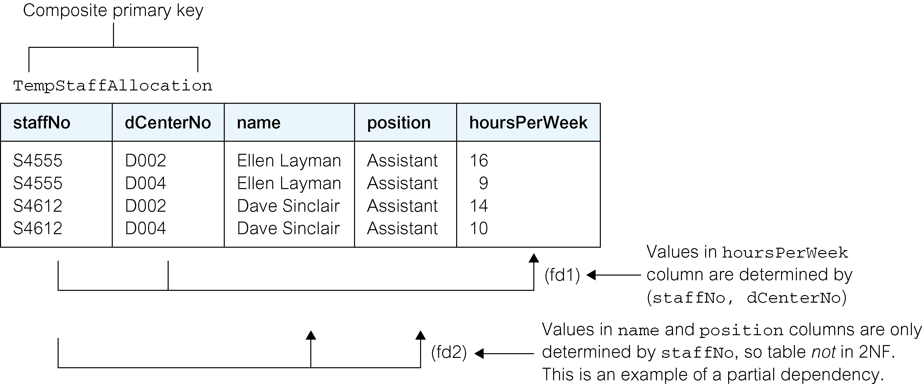
TempStaffAllocation table is not in 2NF

Slide 40
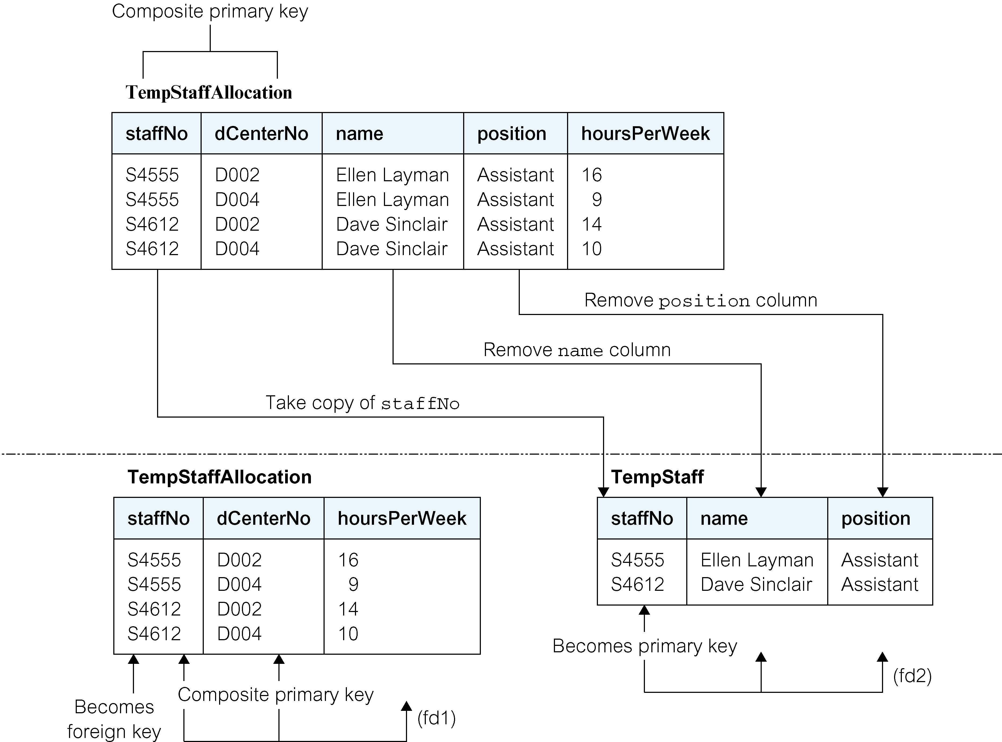
Converting TempStaffAllocation table to 2NF

Slide 41
Third normal form (3NF)
A table that is in 1NF and 2NF and in which the values in all non-primary-key column can be determined from only the primary key column(s) and no other columns.
The formal definition of 3NF is a table that is in 1NF and 2NF and in which no non-primary-key column is transitively dependent on the primary key.

Slide 42
Third normal form (3NF)
A transitive dependency describes a relationship between columns a, b, and c. If a determines b (a → b) and b determines c (b → c), then c is transitively dependent on a via b (provided that b or c does not determine a).
Identification of transitive dependencies on the primary key is evidence that a table is breaking 3NF and may suffer from update anomalies.

Slide 43
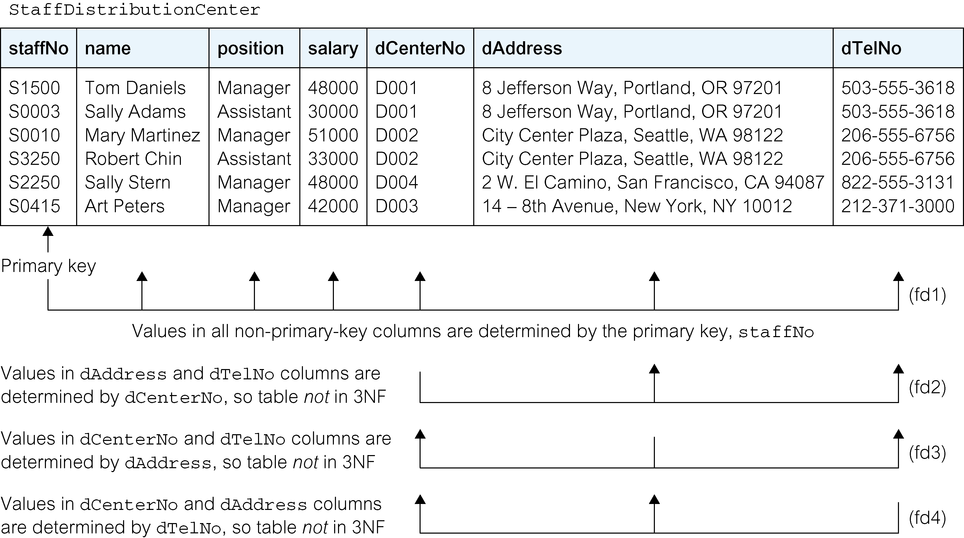
The StaffDistributionCenter table is not in 3NF

Slide 44
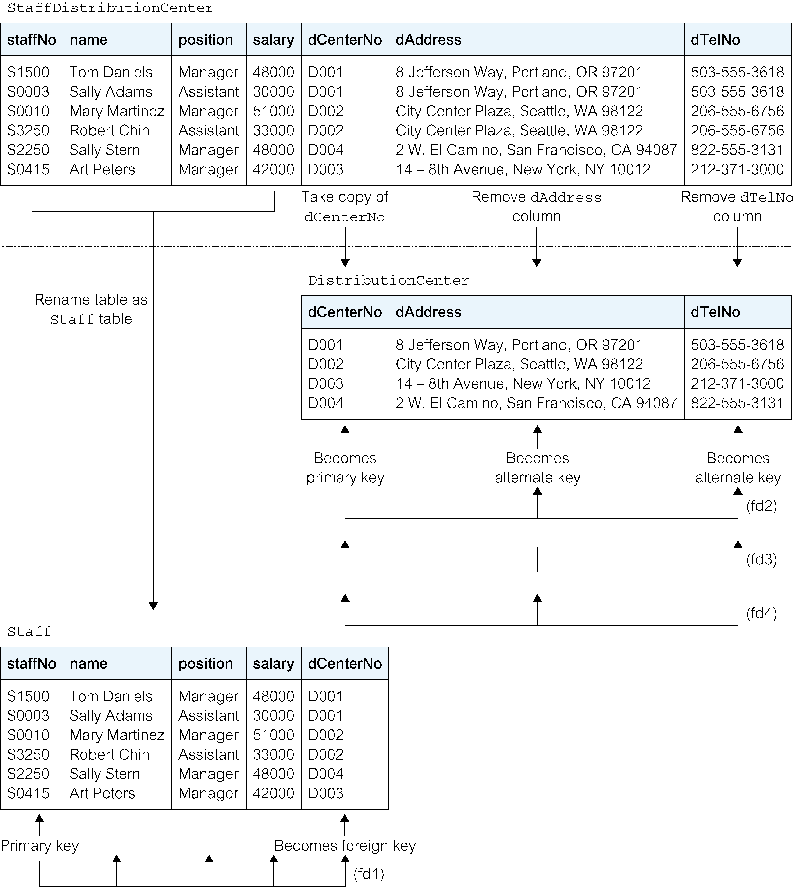
Converting StaffDistributionCenter table to 3NF

Slide 45
General Definitions of Second and Third Normal Forms

Slide 46
More examples

Slide 48
Summary
Informal guidelines for good design
Functional dependency
  Basic tool for analyzing relational schemas
Normalization:
  1NF, 2NF, 3NF,

